Slide 1
Cornerstone City Church Peninsula Plus Community Hoo Are Ya
23rd November 2025

Slide 2
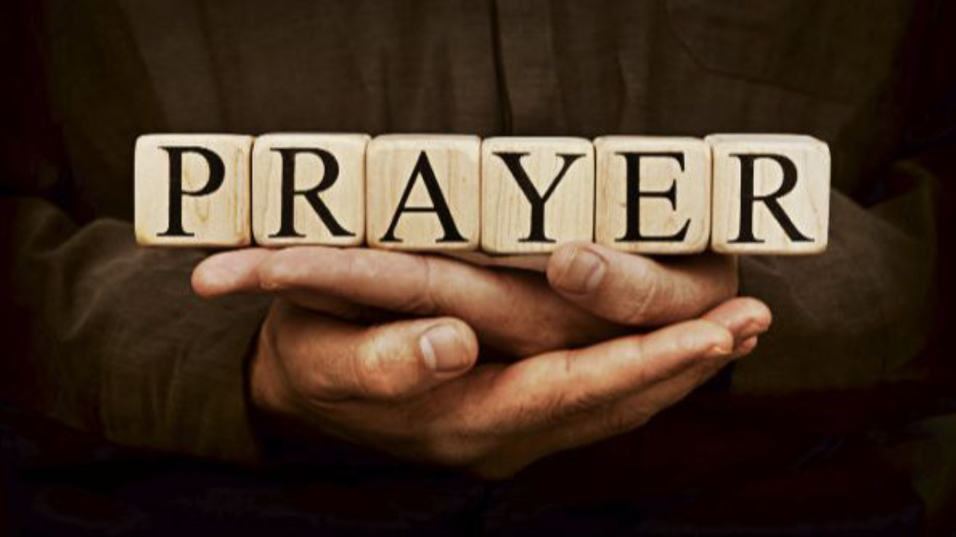

Slide 3
Praise
CCLI Song # 7213077
© Brandon Lake MusicFor Humans PublishingMaverick City PublishingCapitol CMG GenesisCapitol CMG ParagonHousefires SoundsWriter's Roof PublishingMusic by Elevation Worship Publishing
For use solely with the SongSelect® Terms of Use. All rights reserved. www.ccli.com
Note: Reproduction of this sheet music requires a CCLI Music Reproduction Licence. Please report all copies.
CCLI Licence No. 33265

Slide 4
1/12
Let everything that has breath
Praise the Lord
Praise the Lord

Slide 5
2/12
I’ll praise in the valley
Praise on the mountain
I’ll praise when I’m sure
Praise when I’m doubting

Slide 6
3/12
I’ll praise when outnumbered
Praise when surrounded
'Cause praise is the water
My enemies drown in

Slide 7
4/12
As long as I’m breathing
I’ve got a reason to Praise the Lord oh my soul
Praise the Lord oh my soul

Slide 8
5/12
I’ll praise when I feel it
And I’ll praise when I don’t
I’ll praise 'cause I know
You’re still in control

Slide 9
6/12
'Cause my praise is a weapon
It’s more than a sound
My praise is the shout
That brings Jericho down

Slide 10
7/12
As long as I’m breathing
I’ve got a reason to Praise the Lord oh my soul
Praise the Lord oh my soul

Slide 11
8/12
I won’t be quiet
My God is alive
How could I keep it inside
Praise the Lord oh my soul

Slide 12
9/12
I’ll praise 'cause You’re sovereign
Praise 'cause You reign
Praise 'cause You rose and defeated the grave
I’ll praise 'cause You’re faithful
Praise 'cause You’re true
Praise 'cause there’s nobody greater than You

Slide 13
10/12
Praise the Lord oh my soul
Praise the Lord oh my soul
Praise the Lord oh my soul
Praise the Lord oh my soul
I won’t be quiet
My God is alive
How could I keep it inside

Slide 14
1 1/12
I won’t be quiet
My God is alive
How could I keep it inside
I won’t be quiet
My God is alive
How could I keep it inside
Praise the Lord oh my soul

Slide 15
12/12
Let everything that has breath
Praise the Lord
Praise the Lord

Slide 16
This Is Amazing Grace
CCLI Song # 6333821
Jeremy Riddle | Josh Farro | Phil Wickham
© 2012 WC Music Corp. (Admin. by / Small Stone Media BV, Holland (Admin. in the UK/Eire by Song Solutions www.songsolutions.org))
Bethel Music Publishing (Admin. by Song Solutions)
Phil Wickham Music (Admin. by Song Solutions www.songsolutions.org)
Seems Like Music (Admin. by Song Solutions www.songsolutions.org)
Sing My Songs (Admin. by Song Solutions www.songsolutions.org)
For use solely with the SongSelect® Terms of Use. All rights reserved. www.ccli.com
CCLI Licence No. 33265

Slide 17
1/8
Who breaks the power of sin and darkness
Whose love is mighty and so much stronger
The King of Glory the King above all kings

Slide 18
2/8
Who shakes the whole earth with holy thunder
And leaves us breathless in awe and wonder
The King of Glory the King above all kings

Slide 19
3/8
This is amazing grace
This is unfailing love
That You would take my place
That You would bear my cross
You laid down Your life
That I would be set free
Oh Jesus I sing for all that You've done for me

Slide 20
4/8
Who brings our chaos back into order
Who makes the orphan a son and daughter
The King of Glory the King of Glory

Slide 21
5/8
Who rules the nations with truth and justice
Shines like the sun in all of its brilliance
The King of Glory the King above all kings

Slide 22
6/8
This is amazing grace
This is unfailing love
That You would take my place
That You would bear my cross
You laid down Your life
That I would be set free
Oh Jesus I sing for all that You've done for me

Slide 23
7/8
Worthy is the Lamb who was slain
Worthy is the King who conquered the grave
Worthy is the Lamb who was slain
Worthy is the King who conquered the grave
Worthy is the Lamb who was slain
Worthy is the King who conquered the grave
Worthy is the Lamb who was slain
Worthy worthy worthy

Slide 24
8/8
This is amazing grace
This is unfailing love
That You would take my place
That You would bear my cross
You laid down Your life
That I would be set free
Oh Jesus I sing for all that You've done for me

Slide 26
Firm Foundation (He Won't)
CCLI Song # 7188203
Austin Davis | Chandler Moore | Cody Carnes
© 2021 For Humans Publishing (Admin by Essential Music Publishing)
Maverick City Publishing (Admin by Essential Music Publishing)
Capitol CMG Paragon (Admin. by Capitol CMG Publishing)
TBCO Publishing (Admin. by Capitol CMG Publishing)
Writer's Roof Publishing (Admin. by Capitol CMG Publishing)
A.L.K.D. Music (Admin. by Watershed Music Group (Admin. by Capitol CMG Publishing))
For use solely with the SongSelect® Terms of Use. All rights reserved. www.ccli.com
CCLI Licence No. 33265

Slide 27
1/11
Christ is my firm foundation
The rock on which I stand
When everything around me is shaken
I've never been more glad

Slide 28
2/11
That I put my faith in Jesus
'Cause He's never let me down
He's faithful through generations
So why would He fail now

Slide 29
3/11
He won’t
He won't

Slide 30
4/11
I've still got joy in chaos
I've got peace that makes no sense
So I won't be going under
I'm not held by my own strength

Slide 31
5/11
'Cause I've built my life on Jesus
He's never let me down
He's faithful in every season
So why would He fail now

Slide 32
6/11
He won’t He won't
He won't fail
He won't fail

Slide 33
7/11
Rain came and wind blew
My house was built on You
I'm safe with You
I'm going to make it through

Slide 34
8/11
I'm going to make it through
‘Cause I’m standing strong on You
I’m going to make it through
‘Cause my house is built on You

Slide 35
9/11
Christ is my firm foundation
The rock on which I stand
When everything around me is shaken
I've never been more glad

Slide 36
10/11
That I put my faith in Jesus
'Cause He's never let me down
He's faithful through generations
So why would He fail now

Slide 37
11/11
He won’t He won't
He won't fail
He won't fail

Slide 39
I Could Sing Of Your Love Forever
CCLI Song # 1043199
Martin Smith
© 1994 Curious? Music UK
For use solely with the SongSelect® Terms of Use. All rights reserved. www.ccli.com

Slide 40
1/6
Over the mountains and the sea
Your river runs with love for me
And I will open up my heart
And let the Healer set me free
I'm happy to be in the truth
And I will daily lift my hands
For I will always sing
Of when Your love came down yeah

Slide 41
2/6
I could sing of Your love forever
I could sing of Your love forever
I could sing of Your love forever
I could sing of Your love forever

Slide 42
3/6
Oh I feel like dancing
It's foolishness I know
But when the world has seen the light
They will dance with joy like we're dancing now

Slide 44
A New Commandment
CCLI Song # 4540290
Andrew Moore | Aniceto Nazareth
© Words: Kevin Mayhew Ltd; Music: 1999 Kevin Mayhew Ltd
For use solely with the SongSelect® Terms of Use. All rights reserved. www.ccli.com

Slide 45
1/2
A new commandment I give unto you
That you love one another
As I have loved you
That you love one another
As I have loved you

Slide 46
2/2
By this shall all know that you are My disciples
If you have love one for another
By this shall all know that you are My disciples
If you have love one for another

Slide 47


Slide 48
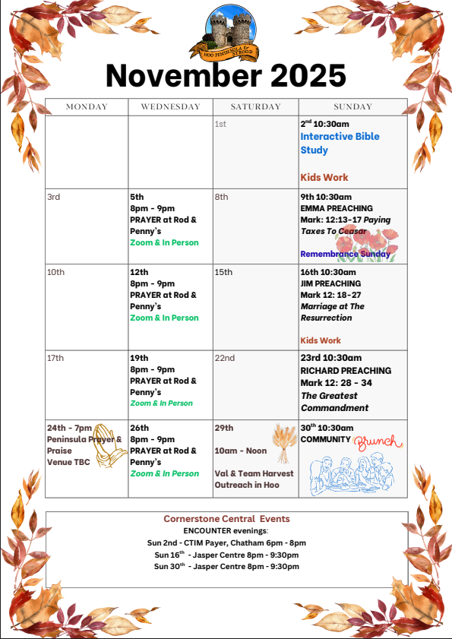

Slide 49
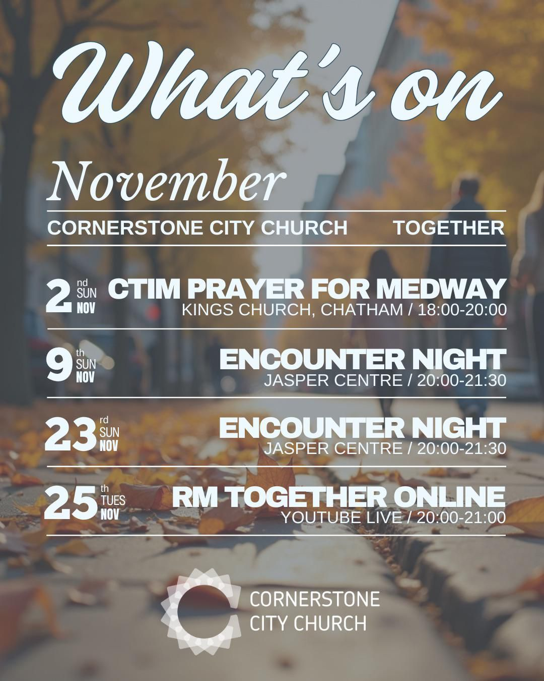

Slide 50
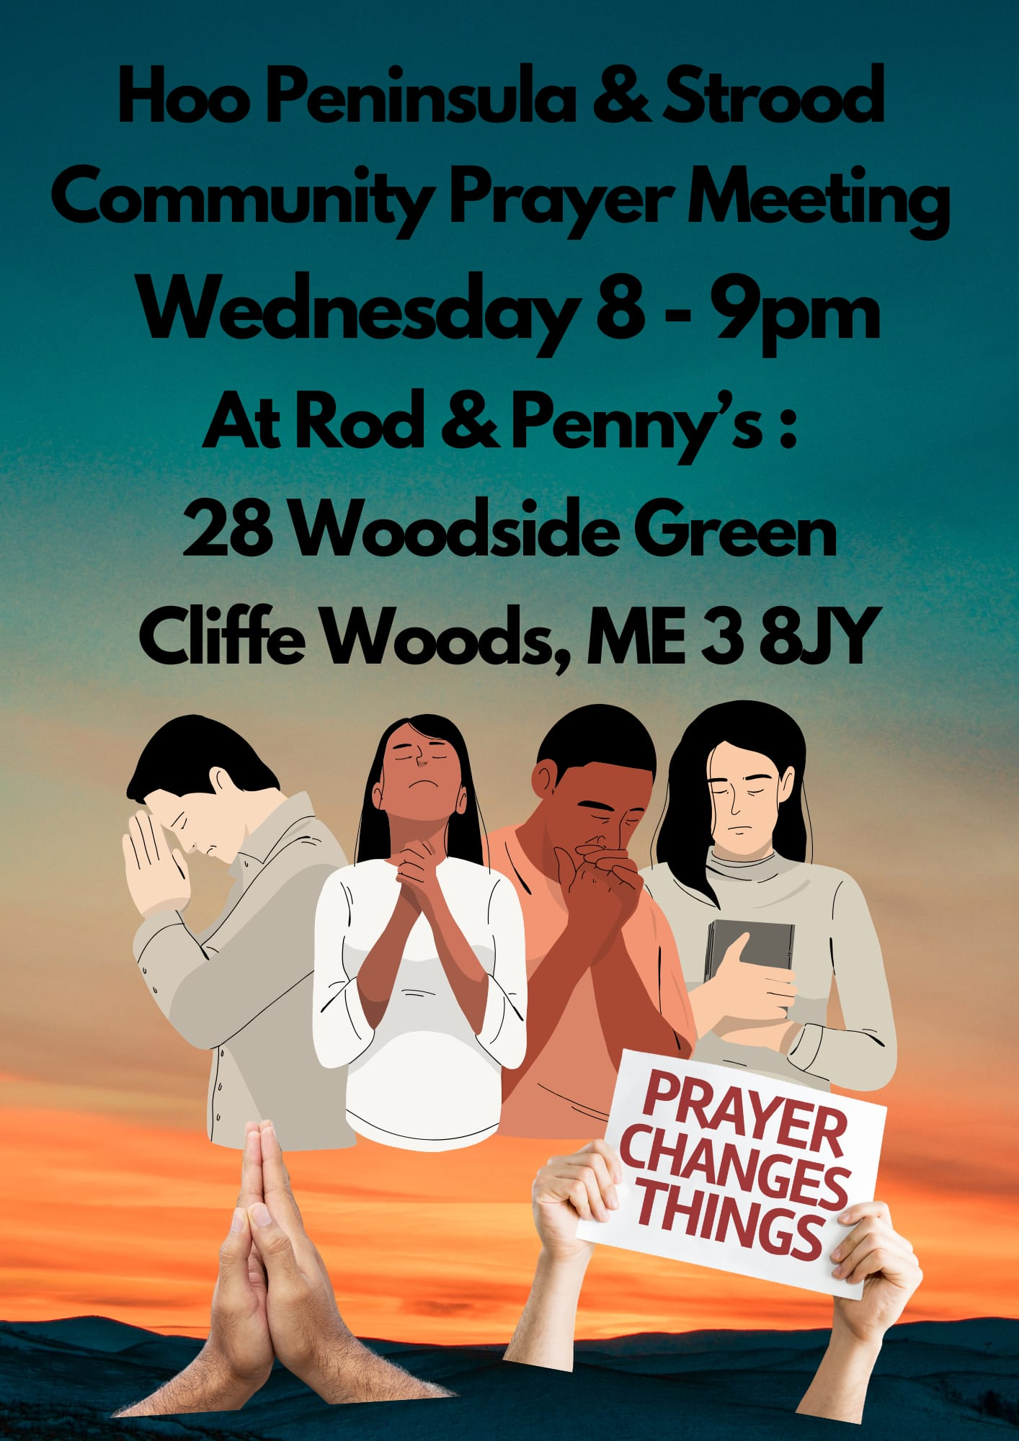

Slide 51
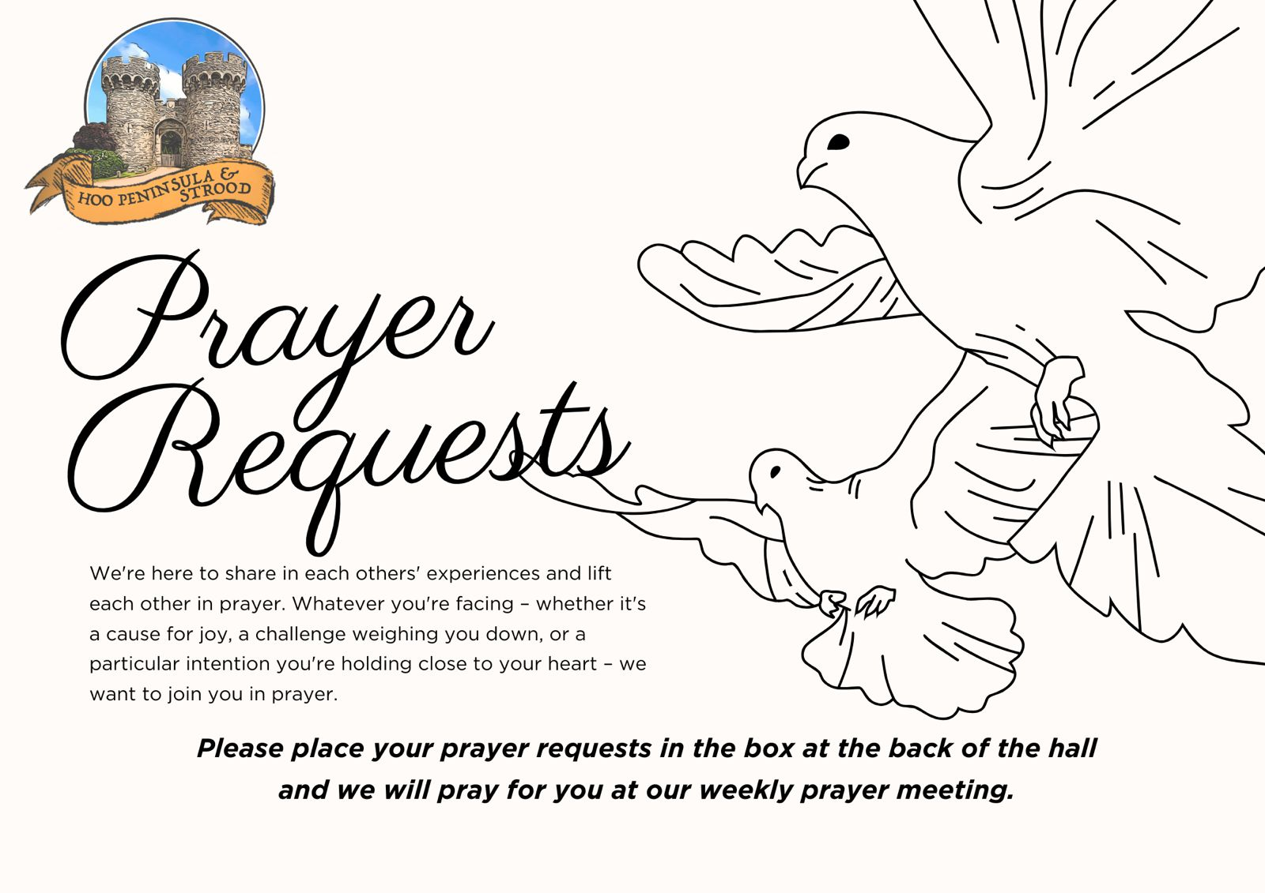

Slide 52


Slide 53
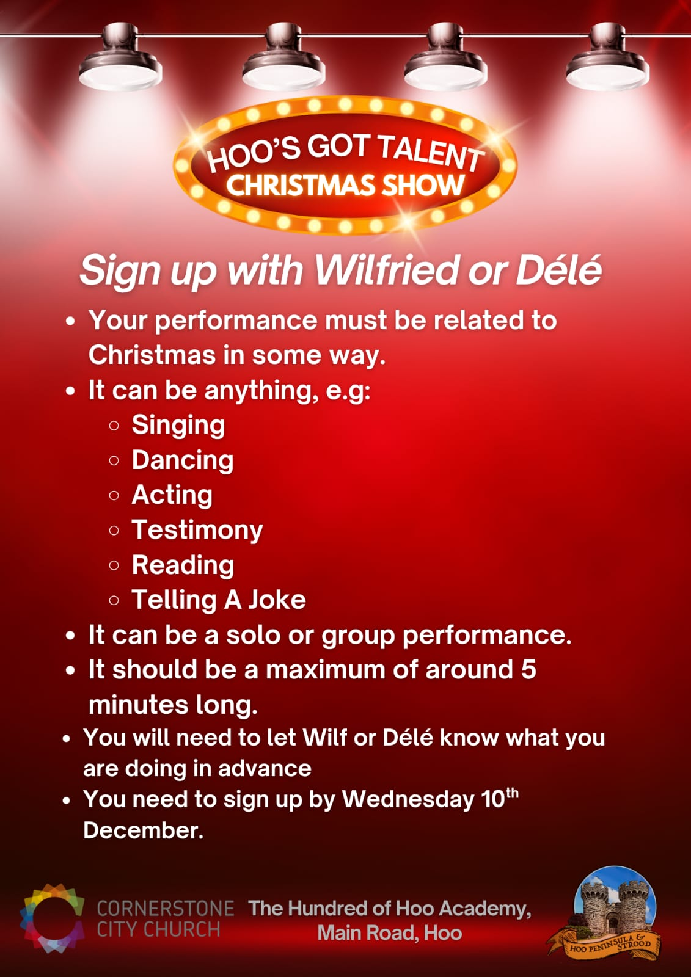

Slide 54

Grow Group 1
On YOUR MARK!

Slide 55
Leaders
Leaderss
Phil & Kim
Maria (Mia) Warren
Matthew Harrison
Richard & Elisha Acheampong
Phil & Kim
Maria (Mia) Warren
Matthew Harrison
Richard & Elisa Acheampong

Slide 56

Storm Walker
Storm Walker
Symbolising, trust in Jesus Christ through life's storms.
Mark 4:35-41

Slide 57


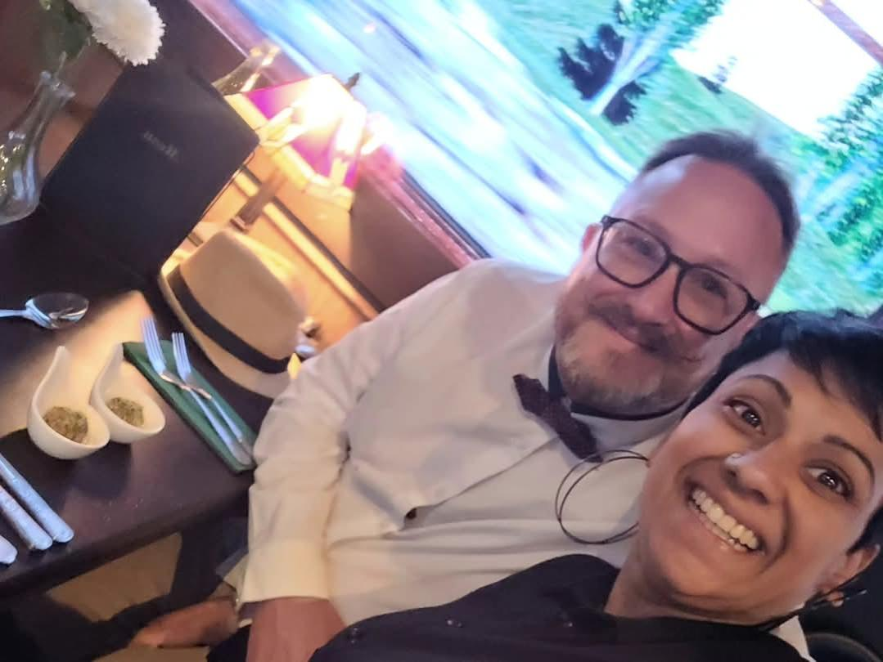
Group Leaders
Micheal and Mwamba
Wilfred and Parveen
Hannah

Slide 58
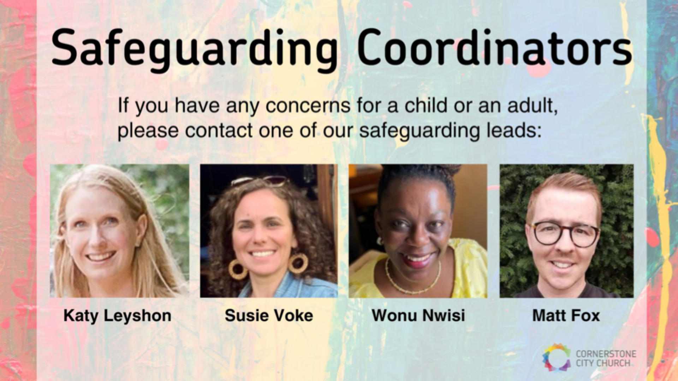

Slide 59
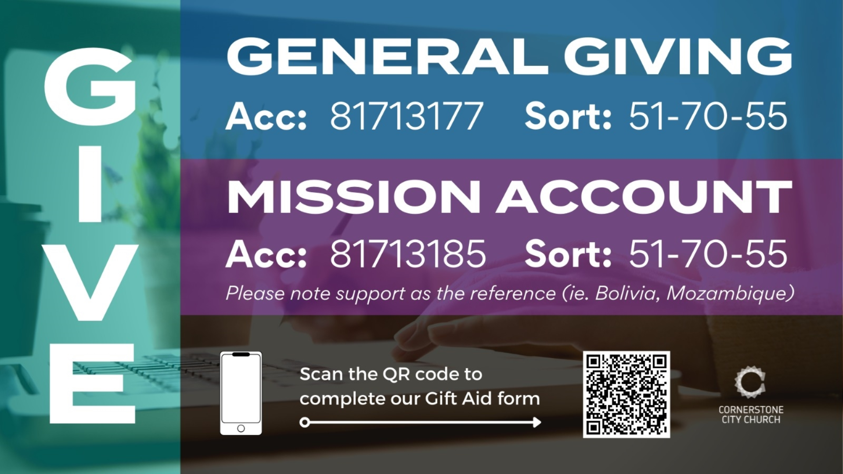

Slide 60


Slide 61
2 Corinthians 14 May the grace of the Lord Jesus Christ, and the love of God, and the fellowship of the Holy Spirit be with you all
Surely goodness and mercy shall follow us all the days of our lives, and we shall dwell in the house of the Lord forever.

